Slide 1
Week 3: Introduction to Regular Expresssions

Slide 2
Regular Expressions
Regular Expression
Say that R is a regular expression if R is
a for some a in the alphabet Σ,
ϵ,
3. ∅,
(R₁ ∪ R₂), where R₁ and R₂ are regular expressions,
(R₁ ◦ R₂), where R₁ and R₂ are regular expressions,
(R₁∗), where R₁ is a regular expression.

Slide 3
Examples
0∗10∗ = {w : w contains a single 1}
Σ∗1Σ∗ = {w : w has at least one 1}
(ΣΣ)∗ = {w : w is a string of even length}
(0 ∪ ϵ)1∗ = 01∗ ∪ 1∗
1∗∅ = ∅
∅∗ = {ϵ}
R ∪ ∅ = R
R ◦ ϵ = R

Slide 4
Notes
Let R be any regular expression:
R ∪ ∅ = R and R ◦ ϵ = R
R ∪ ϵ may not equal R e.g., if R = 0 then
L(R) = {0} but L(R ∪ ϵ) = {0, ϵ}
R ◦ ∅ may not equal R e.g., if R = 0 then
L(R) = {0} but L(R ◦ ∅) = ∅

Slide 5
Regular Expressions and Regular Languages
Theorem 7
A language is regular if and only if some regular expression
describes it.
Lemma 8
If a language is described by a regular expression, then it is
regular.
Lemma 9
If a language is regular, then it is described by a regular
expression.

Slide 6
Example of GNFA
aa
ab∗
ab ∪ ba
(aa)∗
qstart
_{a}∗
∅
qaccept
_{b}∗
ab
b

Slide 7
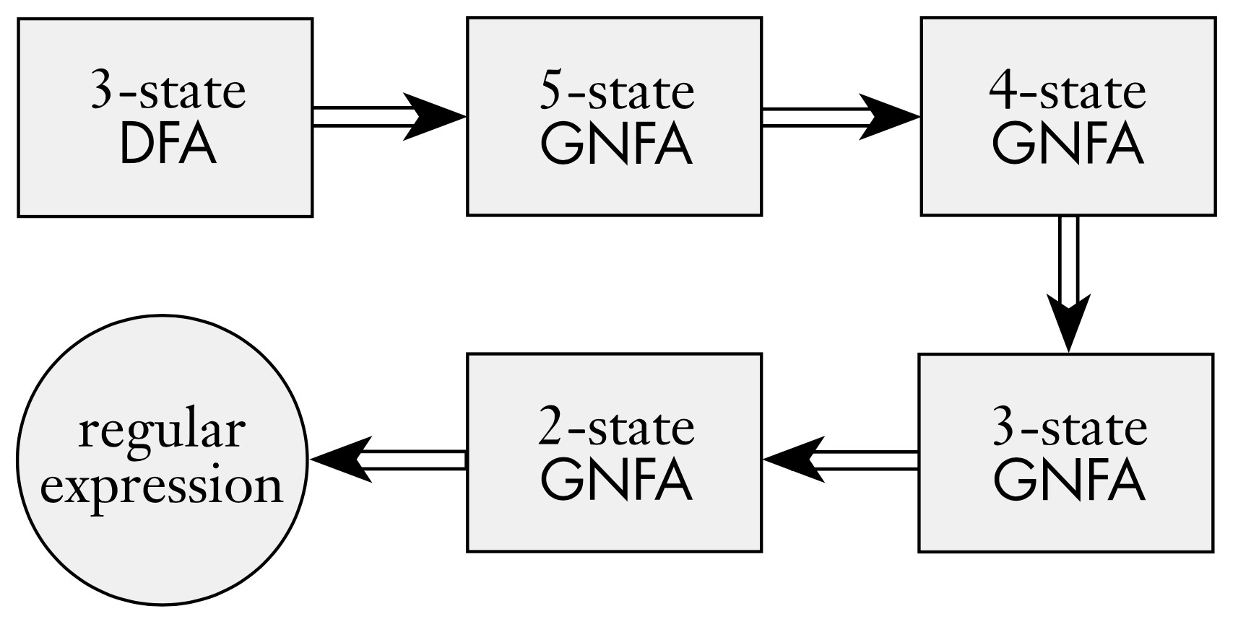
DFA to Regular Expression using GNFA

Slide 8
Generalized Nondeterministic Finite Automata
GNFA
A generalized nondeterministic finite automaton is a 5-tuple, (Q, Σ, δ, q_{start}, q_{accept}), where
Q is the finite set of states,
Σ is the input alphabet,
δ : (Q \ {q_{accept}}) × (Q \ {q_{start}}) → R is the transition function,
q_{start} is the start state, and
q_{accept} is the accept state.

Slide 9
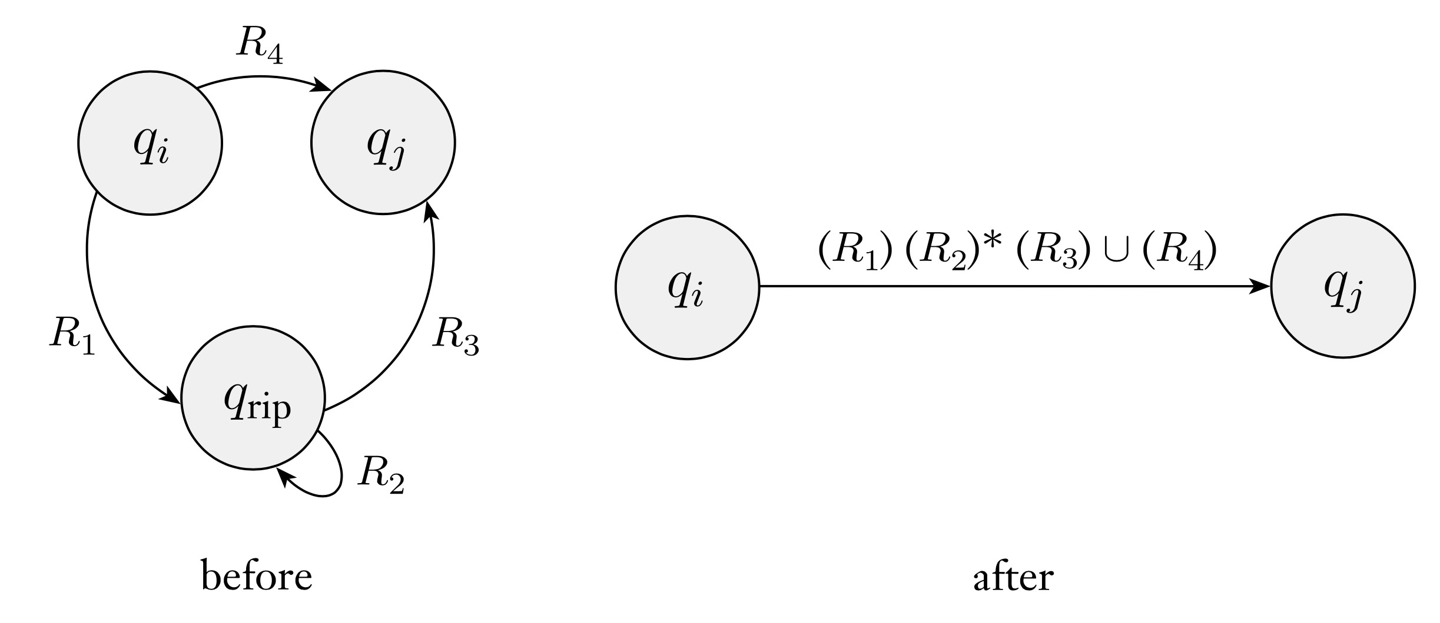
DFA to Regular Expression using GNFA

Slide 10
Generalized Nondeterministic Finite Automata
A GNFA accepts a string w ∈ Σ∗ if w = w₁w₂ · · · w_{k}, where each
w_{i} is in Σ∗ and a sequence of states q₀, q₁, . . . , q_{k} exists such that
q₀ = q_{start} is the start state,
q_{k} = q_{accept} is the accepth state,
for each i we have w_{i} ∈ L(R_{i}), where R_{i} = δ(q_{i−1}, q_{i}), in other words, R_{i} is the expression on the arrow from q_{i−1} to q_{i}.

Slide 11
Converting DFA to GNFA
convert(G):
Let k be the number of states in G
If k = 2, then G must conists of a start state, an accept state, and a single arrow connecting them labeled with R.E. R
If k > 2, we select any state q_{rip} ∈ Q \ {q_{start}, q_{accept}} and let
G′ be the GNFA (Q′, Σ, δ′, q_{start}, q_{accept}), where
Q′ = Q \ {q_{rip}}, and for any q_{i} ∈ Q′ \ {q_{accept}} and any
q_{j} ∈ Q′ \ {q_{start}} let
δ′(q_{i}, q_{j} ) = (R₁)(R₂)∗(R₃) ∪ (R₄),
for R₁ = δ(q_{i}, q_{rip}), R₂ = δ(q_{rip}, q_{rip}), R₃ = δ(q_{rip}, q_{j} ), and
R₄ = δ(q_{i}, qj)
Compute convert(G′) and return this value.

Slide 12
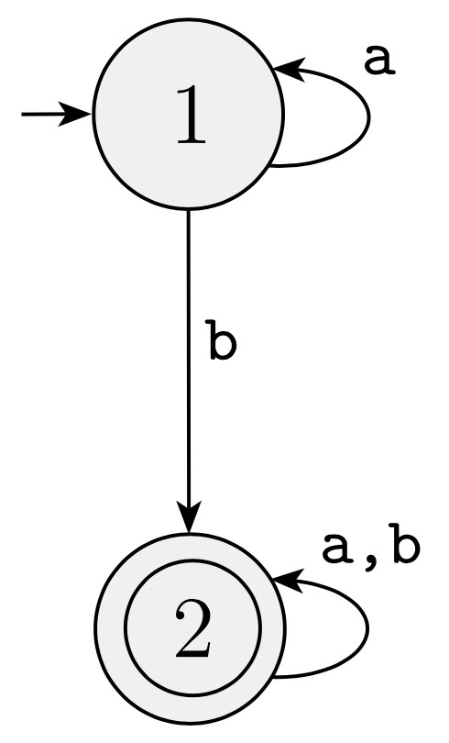
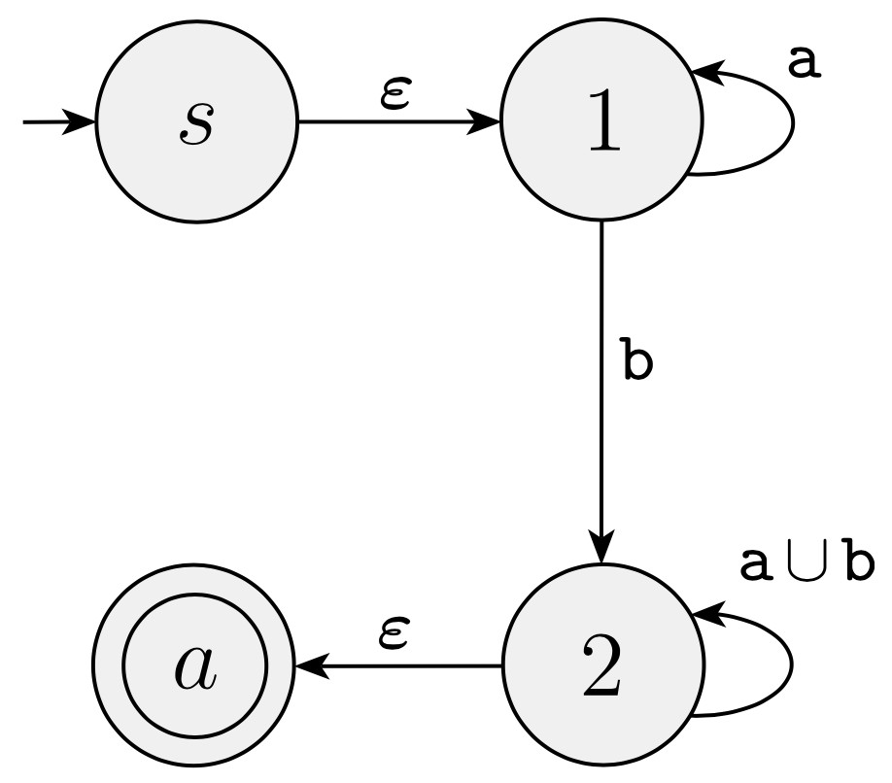
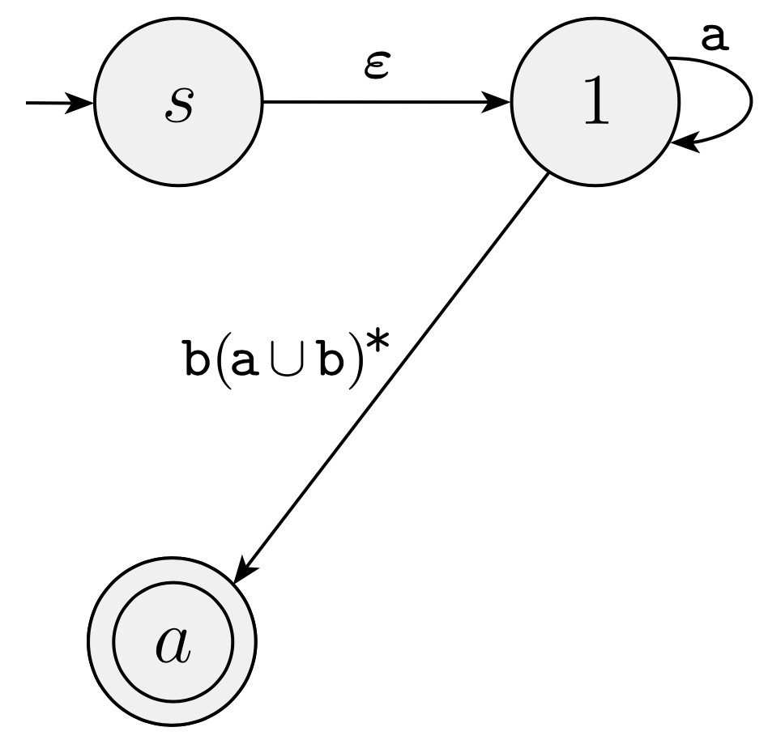
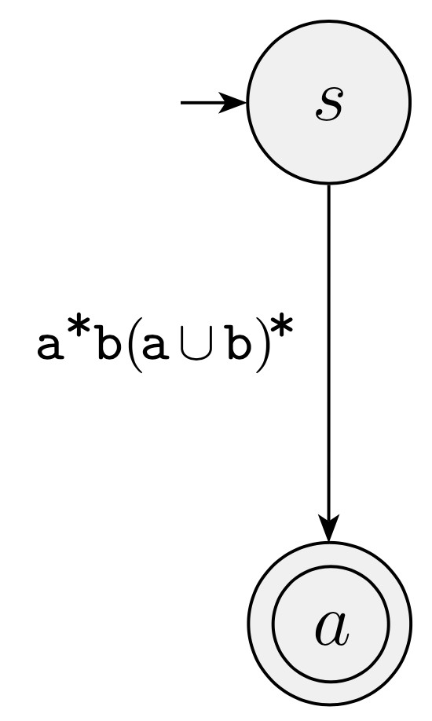
Example: DFA to GNFA
(a)
(b)
(c)
(d)

Slide 13
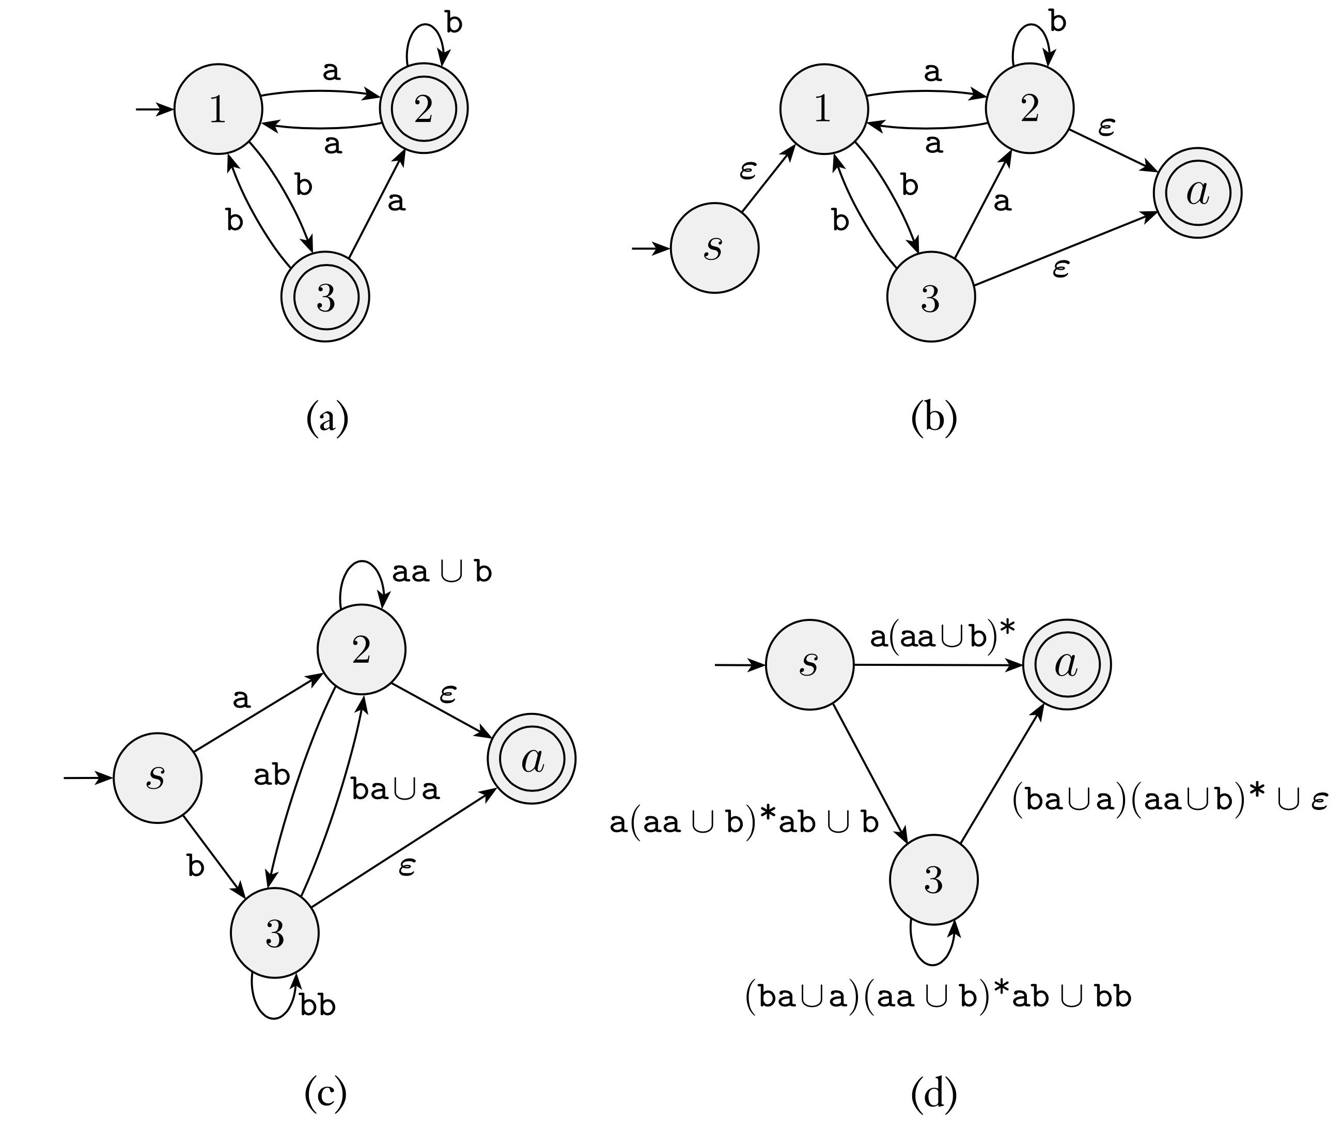
Example: DFA to GNFA

Slide 14
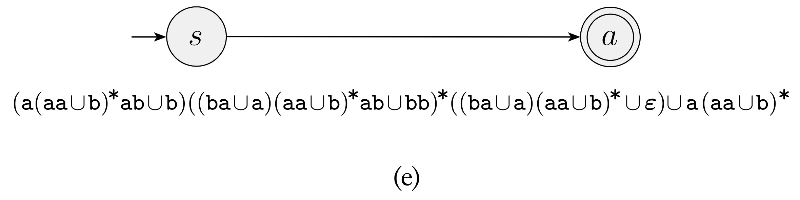
Example: DFA to GNFA

Slide 15
Nonregular Language
Not all languages are regular for example
L = {0^{n}1^{n} : n ≥ 0}
Now consider two languages over Σ = {0, 1}, are they regular?
C = {w : w has an equal number of 0s and 1s},
D = {w : w has an equal number of 01s and 10s as substrings}
C is not regular but D is :)

Slide 16
Pumping Lemma for Regular Languages
Lemma 10
If A is a regular language, then there is a number p (the pumping length) where, if s is any string in A of length at least p, then s may be divided into three pieces, s = xyz, satisfying the following condition:
1. for each i ≥ 0, xy^{i}z ∈ A,
2. |y| > 0, and
3. |xy| ≤ p.

Slide 17
Proof for Pumping Lemma
Let M = (Q, Σ, δ, q_{q}, F ) be a DFA recognizing A and p the number of states of M
Let s = s₁s₂ . . . , s_{n} be a string in A of length n, n ≥ p
Let r₁, . . . , r_{n+1} be the sequence of states that M enters while processing s, so r_{i+1} = δ(r_{i}, s_{i}) for 1 ≤ i ≤ n, this sequence has length n + 1 which is at least p + 1
Among the first p + 1 elements in the sequence, two must be the same state (by pigeonhole principle)
Let first of them be r_{j} and second r_{l}, r_{l} occurs among the first
p + 1 places in a sequence starting at r₁, we have l ≤ p + 1
Let x = s₁ . . . s_{j−1}, y = s_{j} . . . s_{l−1}, and z = s_{l} . . . , s_{n}
x takes M from r₁ to r_{j} , y takes M from r_{j} to r_{j} , and z
takes M from r_{j} to r_{n+1} (accepting state)
M must accept xy^{i}z for i ≥ 0 and since j ̸= l so |y| > 0 and
l ≤ p + 1 for |xy| ≤ p
43

Slide 18
Using PL to Prove Languages Nonregular
Let B be the language {0^{n}1^{n} : n ≥ 0}
Assume B is regular and p be the pumping length given by the pumping lemma
Let s = 0^{p}1^{p} so s ∈ B and |s| > p therefore s = xyz
For i ≥ 0, xy^{i}z must be in B
y consists only of 0’s so xyyz has more 0’s than 1’s
y consists only of 1, same argument
y consists of both 0’s and 1’s so xyyz may have equal number of 0’s and 1’s but they will be out of order
Hence, B is not regular

Slide 19
Using PL to Prove Languages Nonregular
Let C = {w : w has an equal number of 0s and 1s}
Assume C is regular and p be the pumping length
Let s = 0^{p}1^{p}, s ∈ C and |s| > p therefore s = xyz
Now |xy| ≤ p so s = 0^{p}1^{p} cannot be pumped
If |xy| ≤ p then y must consist only of 0’s so xyyz ∈/ C
Alternately, since B is nonregular, if C were regular C ∩ 0∗1∗
also would be regular
But C ∩ 0∗1∗ = B and we know B is not regular

Slide 20
Using PL to Prove Languages Nonregular
Show that F = {ww : w ∈ {0, 1}∗} is not regular
Show that D = {1^{n2} : n ≥ 0} is not regular. D is the language of all strings of 1s whose length is a perfect square
Show that E = {0^{i}1^{j} : i > j} is not regular

